Slide 1

Closer look to OLIST sellers:
Shipping, delivery time and revenue
By Goda Beinortaite

Slide 2
Main questions asked
Do usually merchants handle the order to logistics partner before the shipping limit date?
How fast is it for customers to receive an order?
Does Pareto principle apply to sellers and their revenue?

Slide 3
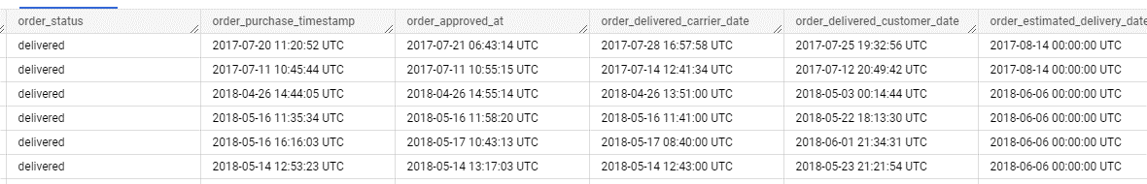
Business insight 1 (data recording)
When analysing data we can see that there are some rows in dataset when timestamps look illogical.
Order had to follow this sequence:
> Approved >> dropped off by the sender at logistic operator >>> customer received their order
Mismatched date entries in the firm’s records indicate some issues that need to be tackled so that the system is more optimized.
Olist should create a more organized and standardized date reporting system so that all the dates entered would be consistent - not earlier than a previous step timestamp.

Slide 4
Business insight 2 (shipping)
97.63% merchants met the shipping deadline in August 2018, which is very high.
Sellers that drop the products late should be penalized, for example, by paying late fees or increasing the commission collected on that order.
This would incentivize more sellers to drop their orders earlier as they would not want to have to pay more commission fees to Olist. This would contribute to reducing the average delivery time.

Slide 5
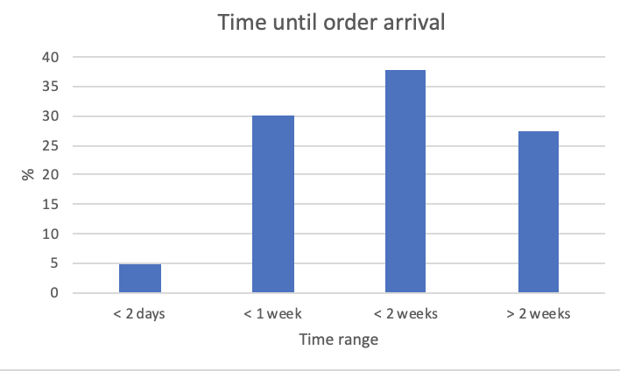
Business insight 3 (delivery time)
Calculated the percentage of orders arriving to customer within 2 days, 1 week, 2 weeks, or more than 2 weeks after they are placed.
Most orders were delivered in 2 weeks (37.73%) after customer’s purchase.
Particularly, categories “auto” and “furniture” took the longest arrival to customers.
This is a KPI Olist should strive to improve and there is a need for some improvements in Olist delivery chain to get products delivered earlier.
We should aim to analyse medians of every category delivery days in every state to see which categories took the longest.

Slide 6
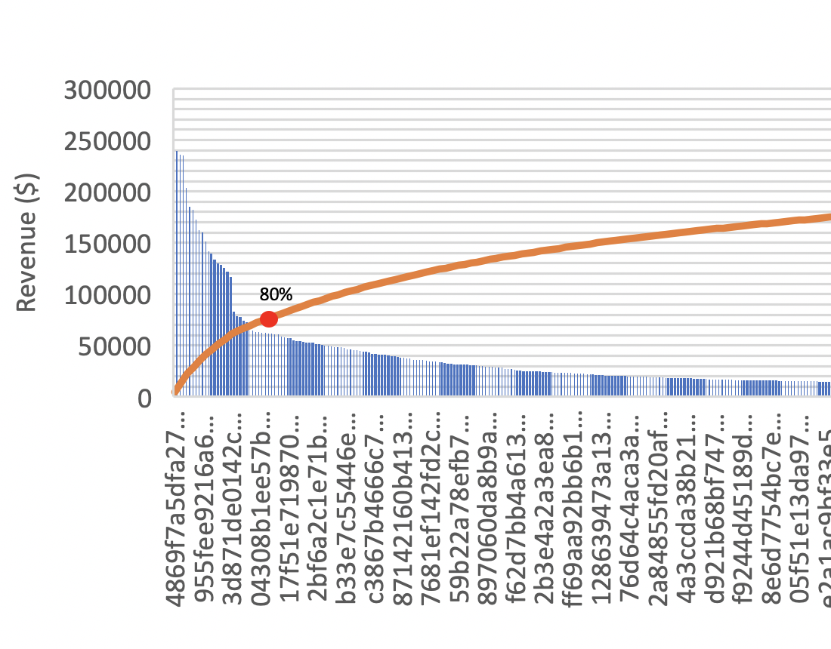
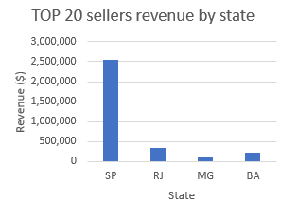
Business insight 4 (Pareto principle and revenue) (1)
Top 551 sellers (out of 2970) comprise roughly 80% of total revenue. That is ~19% of all sellers, so essentially we can conclude Pareto principle applies in this case, meaning 20% sellers control 80% of the sales.
By selecting only top 20 sellers by revenue we can notice that majority of revenue comes from the biggest state - SP.
Business should focus more on these sellers and drive profitability even further.
It would be more useful to take x-axis as LOG function

Slide 7
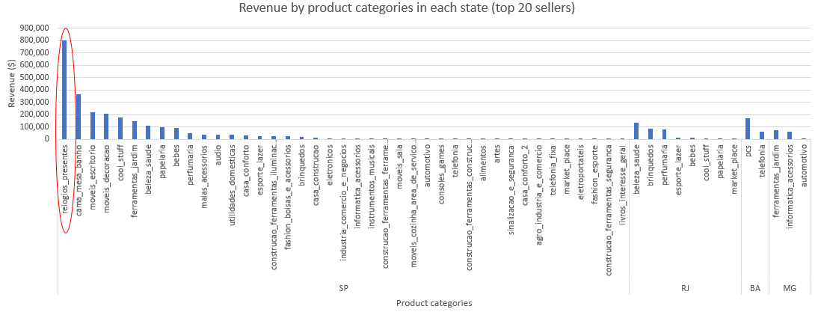
Business insight 4 (Pareto principle and revenue) (2)
When analysing top 20 sellers’ revenue source (20 out of 551 sellers), we can see that 32% of SP revenue comes from gifts and watches (relogios e presentes). This category makes 25% revenue from all states (no such category in other 3 states).

Slide 8
Further possible analysis
Our analysis indicated many on-time deliveries (estimated date after delivery date) but it might be happened due to ineffective method for predicting delivery.
It might be that company has an obsolete software to estimate delivery times. It would be good to check the pattern of estimated date calculation. Long estimated delivery time can deter many buyers.
Also, would be useful to analyse months with higher percentage of late deliveries and more profitable months. Maybe Olist could hire some contract/ part-time delivery people or distributors to reduce the number of late deliveries and increase profit.

